Slide 1
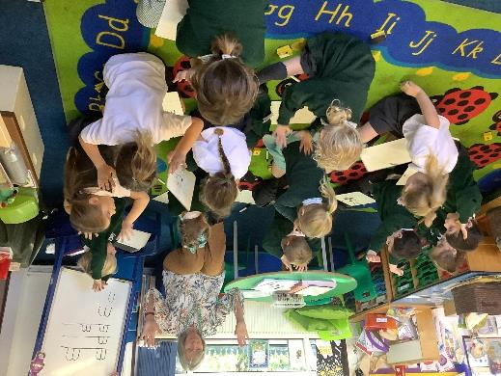
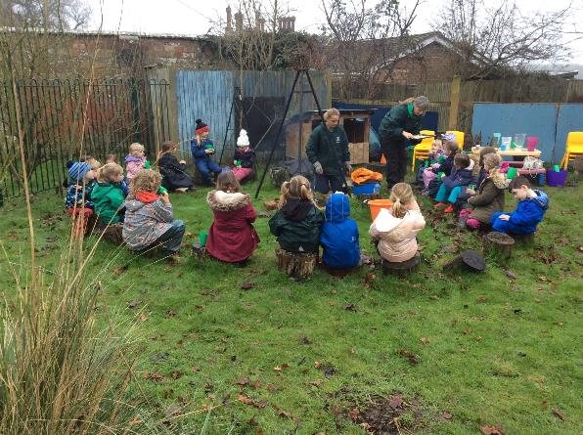
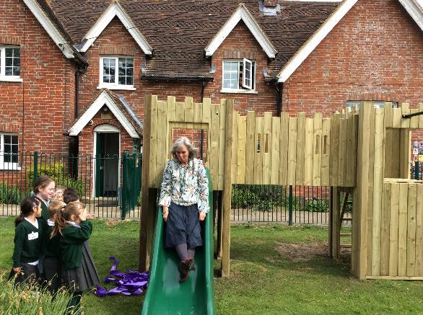
Starting School 2023
Welcome to Shipley Church of England Primary School
Friendship…Faith…Future

Slide 2
Working in partnership with families
Parents and carers
Children
School

Slide 3
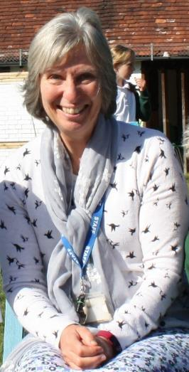
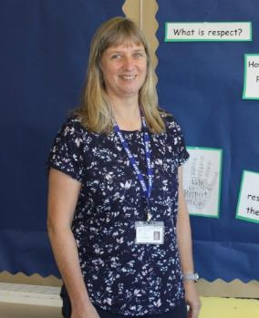
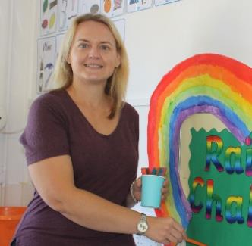
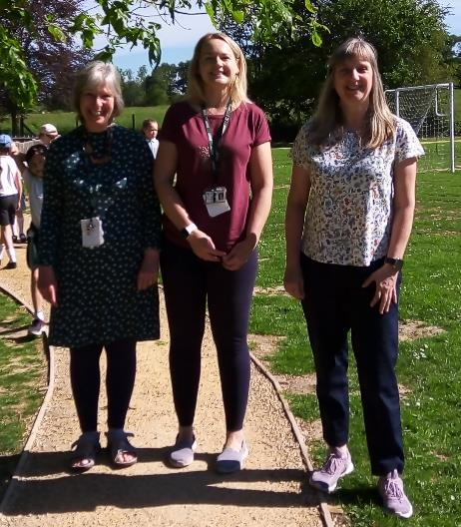
Meet the Willows team
Mrs Dodd
Higher Level
Teaching Assistant
Ms Berry
Higher Level
Teaching Assistant
Mrs Simpson
Willows Class Teacher

Slide 4
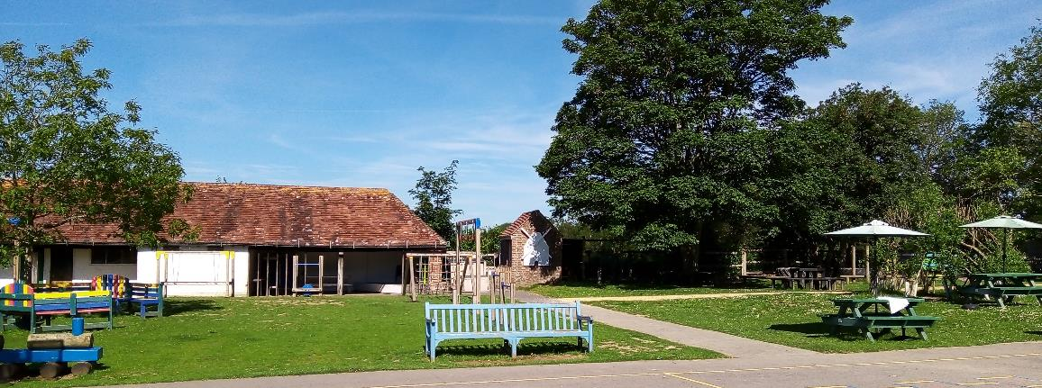
A phased start to the term
Monday 4th September – Storytime 2.15 – 3.00pm
Tuesday 5th September –9.00am – 1.00pm
During this week we will be talking to parents about extending hours. There is flexibility as all children are different.
From Monday 11th September – some children may attend full time

Slide 5
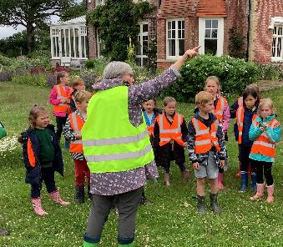
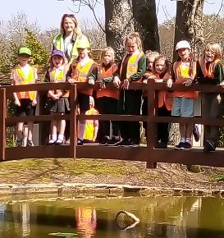
Routines and procedures
Coming into school at 8.40am –parents will leave their children at the door to the classroom where Mrs. Simpson will greet them and take them into the cloakroom.
Leaving School at 3.05pm– children will be handed to parents one at a time at the end of the session.
Lunches/Snacks/Water – every child needs to bring a water bottle but fruit snacks are provided
Book Bag
School green book bag for reading book, library book and reading journal – no need for large backpack
Toys from home
In the first week children may bring one small toy if they need to, after that no toys from home please.
First Aid/illness
First aid will be carried out by qualified first aiders and you will be notified of any illness or head injuries. The school’s medicine policy will be shared with you.

Slide 6
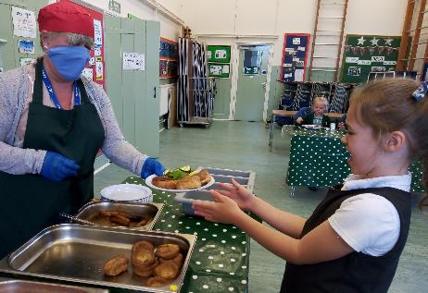
Lunchtime and meals
Children are entitled to Free school meals up to Year 2.
The hot meals are provided by Easy Lunch, a local company who locally source fresh produce. Food is not reheated, it is ‘hot boxed’ so it is hot and fresh. Some children prefer to bring a packed lunch.
The children eat in the hall and are supervised at all times. Mid-day Meals Supervisors provide a variety of activities for the children on the playground and the field after they have finished their lunch.

Slide 7
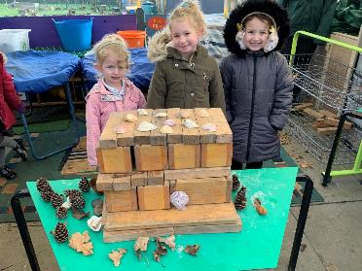
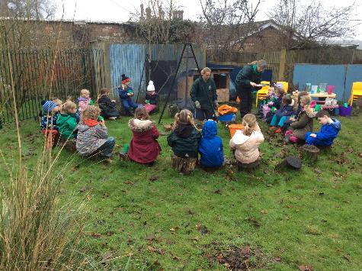
Uniform
A list of school uniform is in the school prospectus,
including school PE kit
Every day at school: wellies, waterproof coat, jumper or cardigan, water bottle
Outdoor Learning clothes: 2 piece waterproofs or all-in-one, wellies, layers – dark colour: short sleeve t-shirt, long sleeve-tshirt, sweatshirt, jogging bottoms
In winter the children can wear thermals or tights

Slide 8
Building Blocks to Starting School
You can help your child make a good start to school by helping them with these building blocks.
I can follow some rules, I can ask for help, I can use cutlery and get myself some water and a snack. I can attempt to dress myself
I can take turns and listen to others. I can help to tidy up when I have finished playing. I can recognise my name and count steps as I go up.
I can interact with others politely and I enjoy exploring new things. I love listening to stories.
I can use the toilet, wash my hands and wipe my nose and put the tissue in the bin. I can mark make.
I have a good routine and I can separate from my parents or main carer. I like to explore messy play.

Slide 9
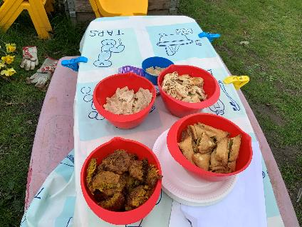
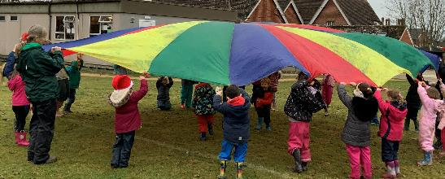
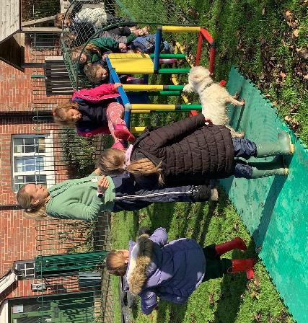
Physical Development and Outdoor Learning
There will be 2 PE/music and movement sessions a week. These will give the children a mixture of movement and games skills. They will also have a wide variety of outdoor learning that will encourage physical development.
The children will have one whole morning session of Outdoor Learning activities a week. Some weeks we will have a fire with hot chocolate and food that is relevant to our topic or another area of the curriculum. Other Outdoor Learning sessions will happen most days.

Slide 10
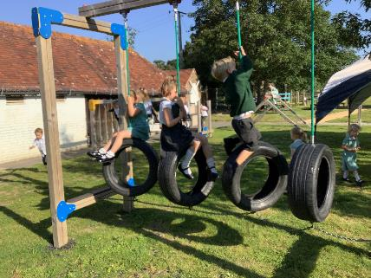
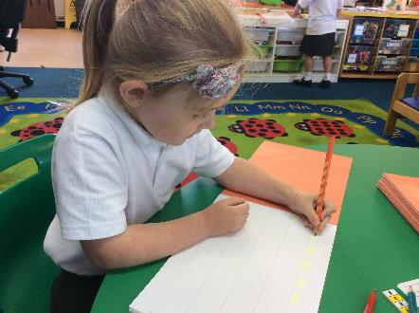
Early Years Curriculum September 2023
Quality and consistency in early years, reception classrooms, so that every child makes good progress and no child gets left behind
• a secure foundation through planning for the learning and development of each individual child
• partnership working between teachers and with parents and/or carers
• equality of opportunity and anti-discriminatory practice, ensuring that every child is included and supported

Slide 11
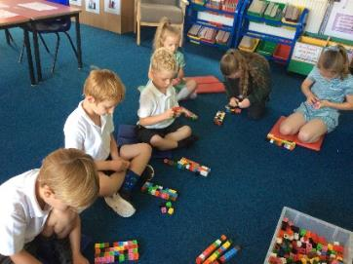
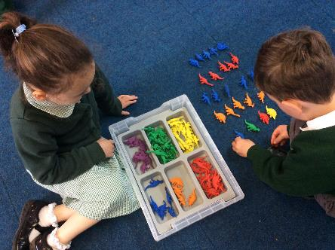
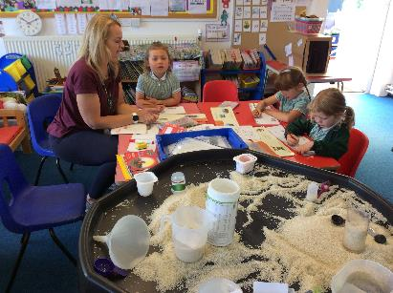
These are the characteristics of effective learning • playing and exploring • active learning • creating and thinking critically Within these areas, skills in these subjects will be taught and explored: • communication and language • literacy mathematics personal, social and emotional development physical development • understanding the world • expressive arts and design

Slide 12
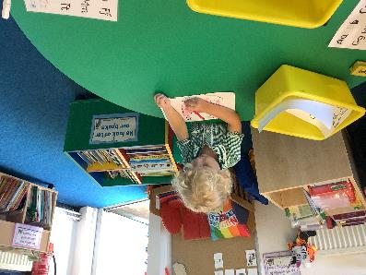
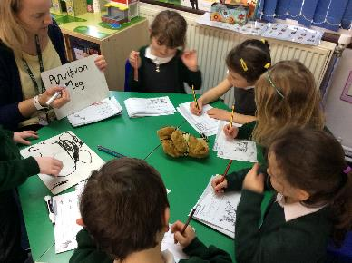
Literacy and English
At Shipley we use the Read, Write, Inc. phonics and reading scheme
This starts with a daily phonics lesson which teaches the children the 44 phonic sounds they need to read – speed sounds 1, 2, & 3
a daily word based session to use the phonic sounds
Later in the year; a daily reading session to use the words in a book and start to understand how books are read and understood
a daily writing session to accompany the reading book, that teaches how to form letters correctly and use phonics and word blending skills as an author
We also use a range of books to engage and inspire the children to have a love of reading and writing

Slide 13
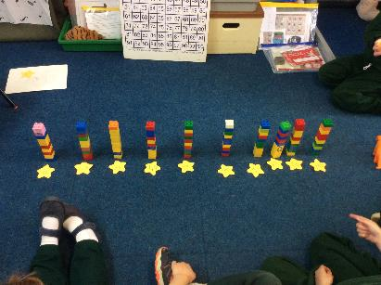
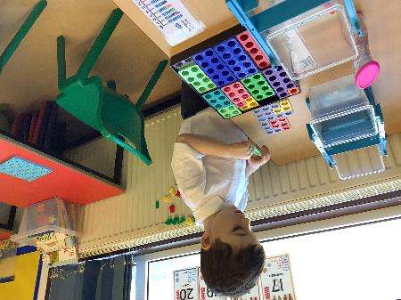
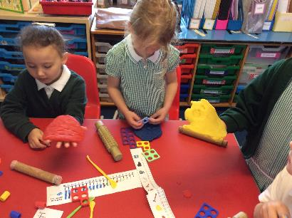
Maths and numeracy
At Shipley we use Numicon, cubes, number blocks and counters as concrete resources that allow the children to explore number in a physical and practical way
Daily activities to explore:
Numbers to 10
Numerical patterns
Comparing numbers
Other areas of maths will be explored too:
Shape, time, fractions, measures

